Slide 1
Flight Delay Project
Ben Marsh
Nasir Hussain

Slide 2
Introduction
The aim of this project is to explore the concept of predicting flight delays using a data-driven approach.
The Process:
Explore flights data
Identify features that can affect flight delay
Develop Machine Learning models to predict flight delay
Evaluate the performance of each ML model

Slide 3
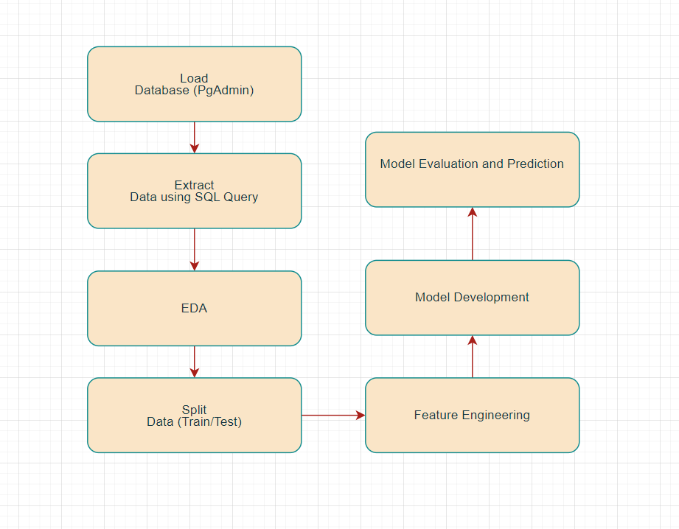
Project Workflow

Slide 4
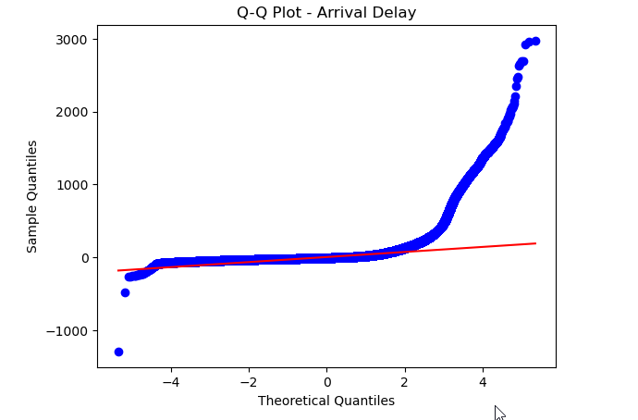
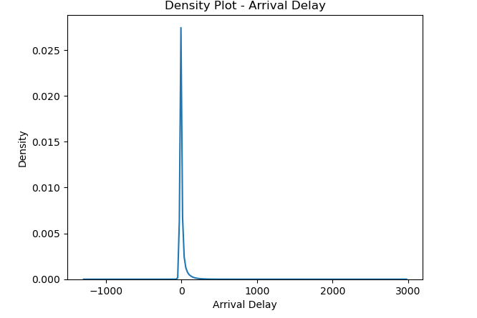
Task : Test the hypothesis that the delay is from Normal distribution. and that mean of the delay is 0
As per the results Shapiro-Wilk test statistics: 0.375, p-value: 0.000 , p-value is less than 0.005
T-Test : The mean delay is significantly different from 0 at the 0.05 level.

Slide 5
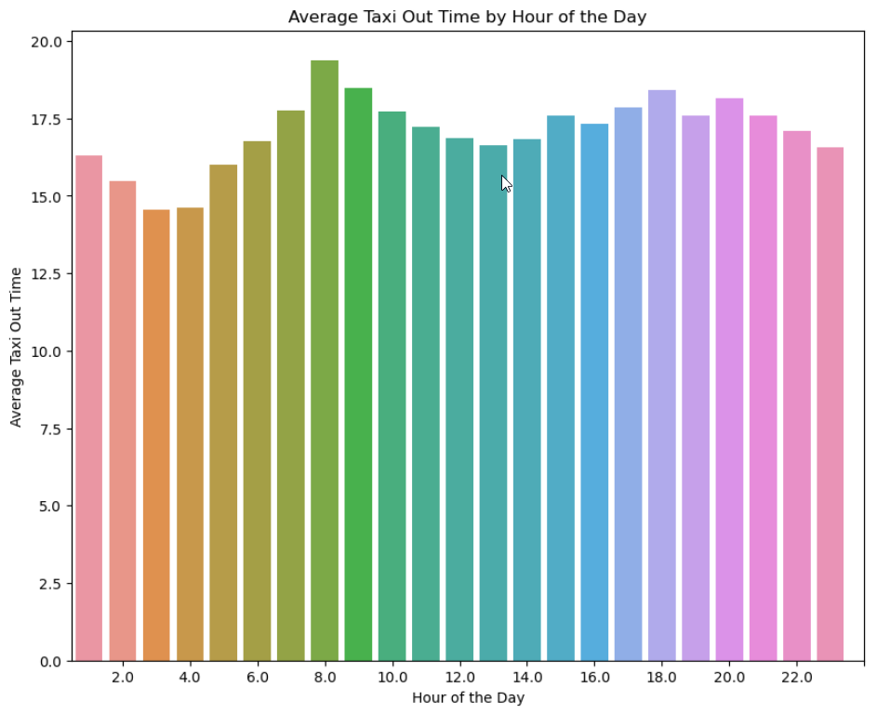
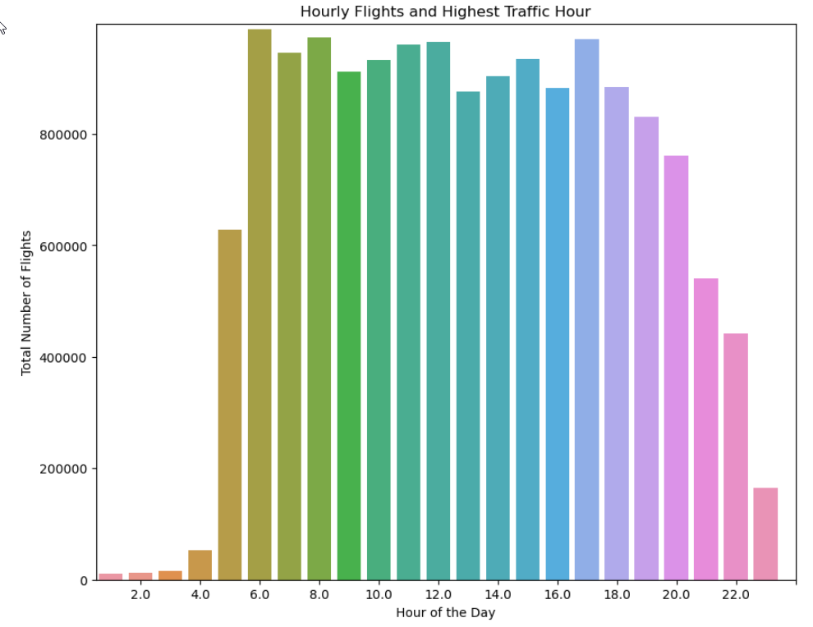
Task : How taxi times changing during the day? Does higher traffic lead to bigger taxi times?
We observe low traffic between 0000-0400 hrs
There is no significant change in Taxi time due to high traffic

Slide 6
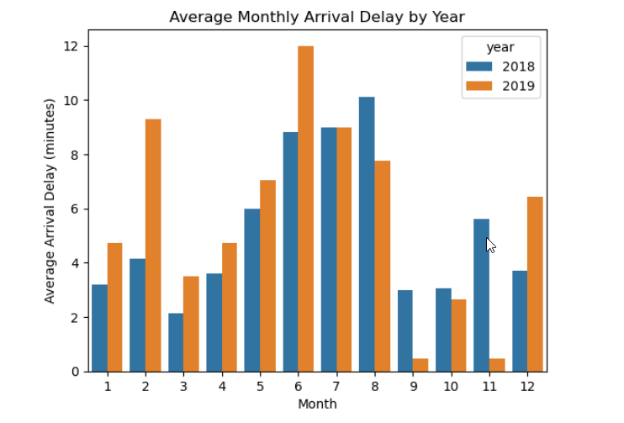
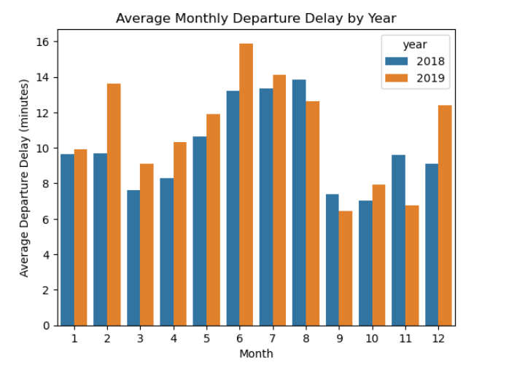
Task : Is average/median monthly delay different during the year? If yes, which are months with the biggest delays and what could be the reason?
We observe that during June and July there are higher count of delays
This could be due to holiday season

Slide 7
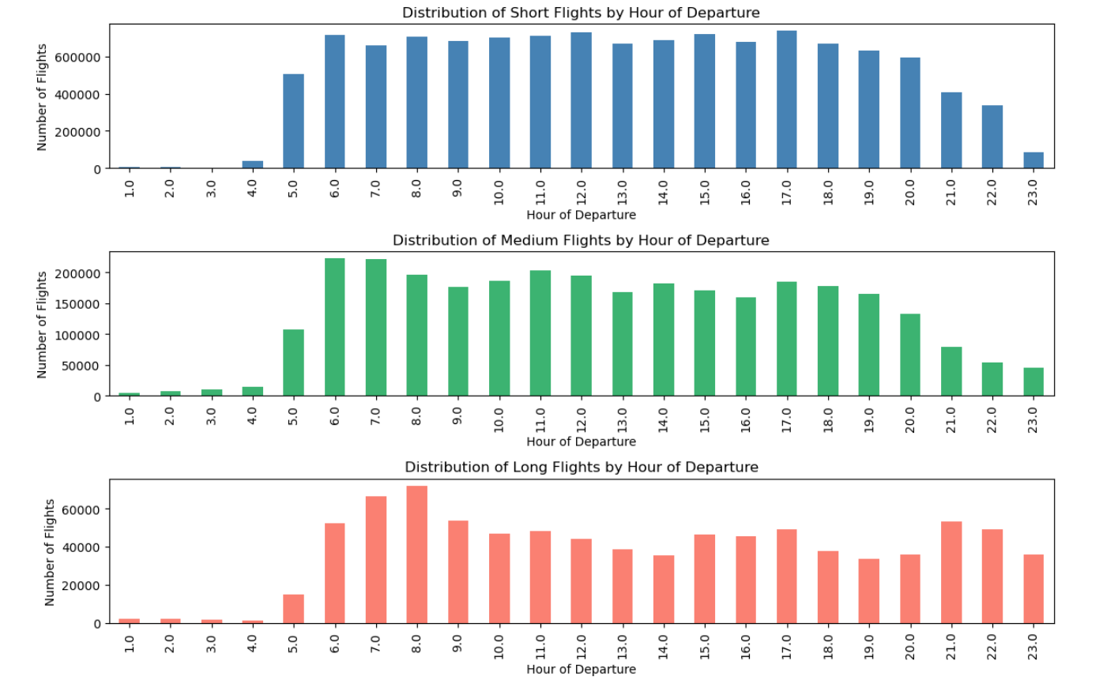
Task : When (which hour) do most 'LONG', 'SHORT', 'MEDIUM' haul flights take off?
Short flights have very large numbers
There are no significant hour for Long,short and long flights

Slide 8
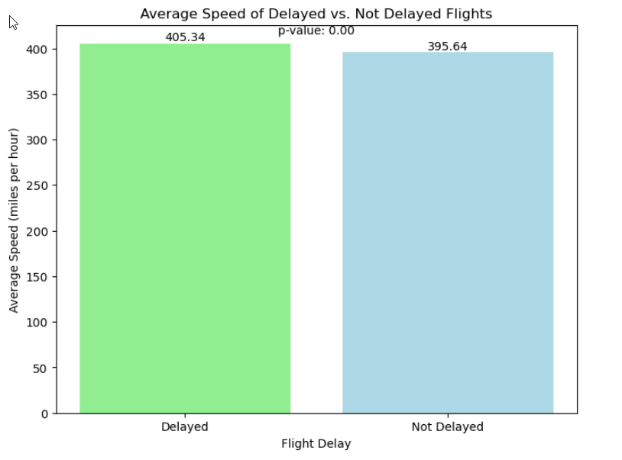
Task : Test the hypothesis whether planes fly faster when there is the departure delay?
Below are the average speed of the delayed vs non-delayed flights
We observe that planes do fly faster if there is departure delay

Slide 9
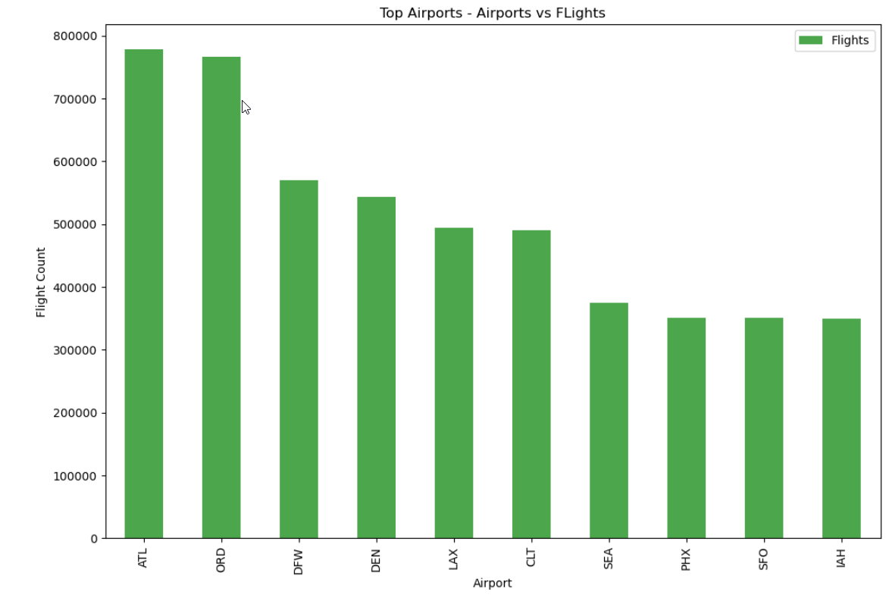
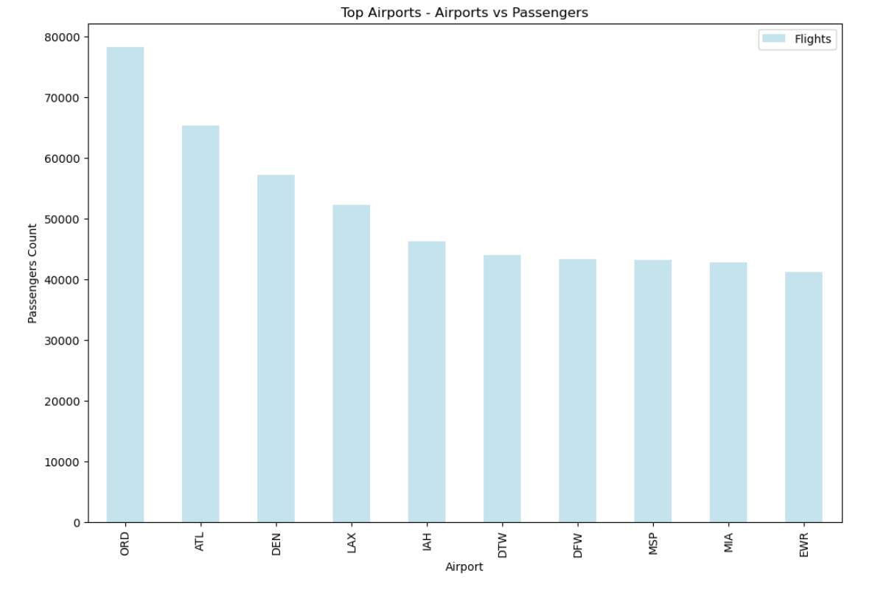
Task :Find the top 10 the busiest airports. Does the biggest number of flights mean that the biggest number of passengers went through the particular airport?
We observe that top airports with biggest number of passengers have most number of flights

Slide 10
Feature Engineering
Checking for Nan and missing values.
Replaced with mean values where necessary
Dropped unnecessary features .
Following new features are created using existing features
Taxi_mean_time : Mean Taxi out time
Time related features : month , day_of_month , day_of_week ,
Dep_hour : 0-24 hrs
Time_of_day : Morning | Afternoon | Evening | Night
Dep_traffic_per_day : Number of flights per day
Avg_delay_per_airline : Average departure delay per airline
Monthly_avg_passengers
Avg_monthly_fuel_gallons
Avg_monthly_fuel_cost

Slide 11
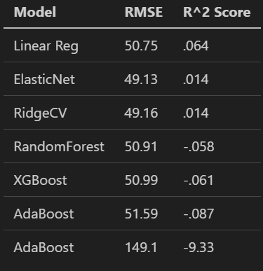
Model Results
Most impactful feature:
Avg Delay per Airline

Slide 12
Challenges and Future Work
Computing Resources - very slow to load and work with the large dataset. We had to try using smaller and smaller samples of the data to train our models, which impacts the accuracy.
Feature Engineering - Our feature set did not result in an accurate model. Back to the drawing board to examine correlations closer and think about what other external data we could pull in.

